Slide 1

Building a GUI for Unix Commands Execution on MacOS
CSCI 6917: Guided Research
Sravya Kuchipudi
08 August 2023

Slide 2
Project Objective
Heilmeier Questions
Objective (What was I going to do?):
Develop a user-friendly graphical user interface (GUI) for executing Unix commands on MacOS.
How is it done today? Current Limitations?
Users have to work directly into the Terminal which requires a pre-existing knowledge of Unix Command syntax and comfort with the Terminal.
What was my idea to do something better? Who will benefit from my work?
Empowers novice users by simplifying the execution of Unix commands, by making it easier to explore and use Unix commands through an intuitive GUI that has instructions, tips, and an aesthetic user interface which overall saves time and effort.
What risks do I anticipate?
Security vulnerabilities in command execution and insufficient error handling.
These were addressed through methods such as input validation and specified error alert messages.
Out of pocket costs? Complete within timeline?
No real cost due to existing access to all necessary tools and a reasonable plan was formulated to stay on track.

Slide 3
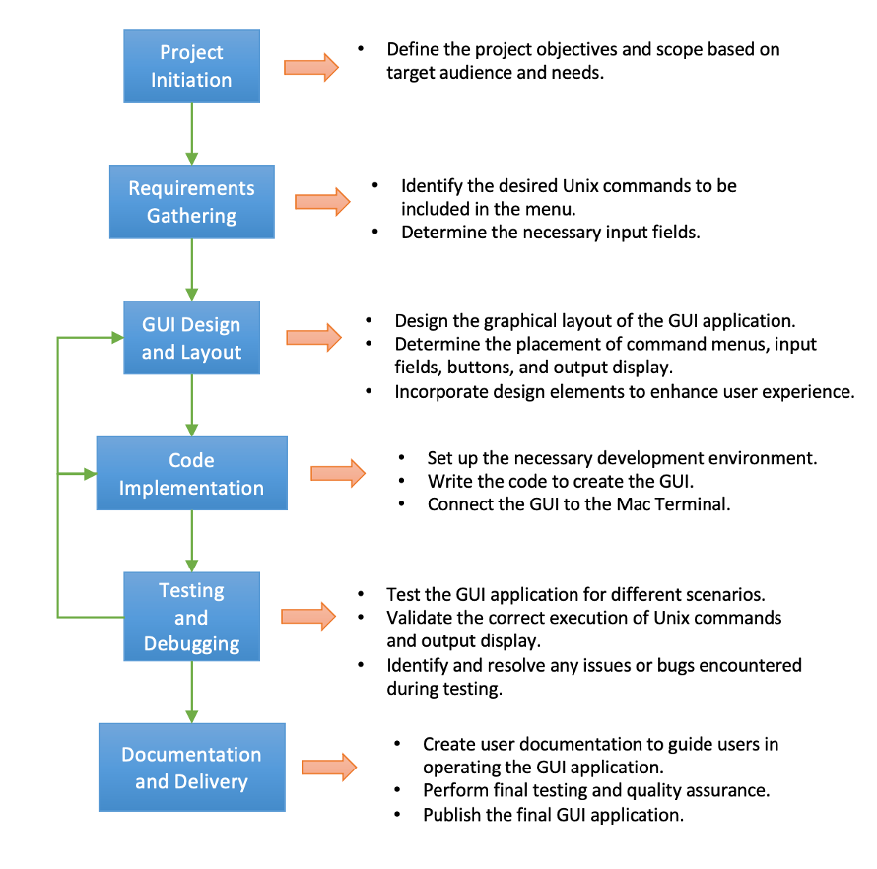
Technical Approach
Project Flow

Slide 4

Technical Approach
Key Steps in Research
Qualitative Approach
To focus on how to facilitate the user's needs and experience and improve through repeated testing.
Explore GUI frameworks for MacOS.
PySimpleGUI and Tkinter.
Choose relevant UNIX commands.
Research the most used and necessary for Terminal use.
Design GUI layout and structure.
Format based on the needs of the commands.
Implement menu-based command selection and argument input.
Develop command execution functionality.

Slide 5
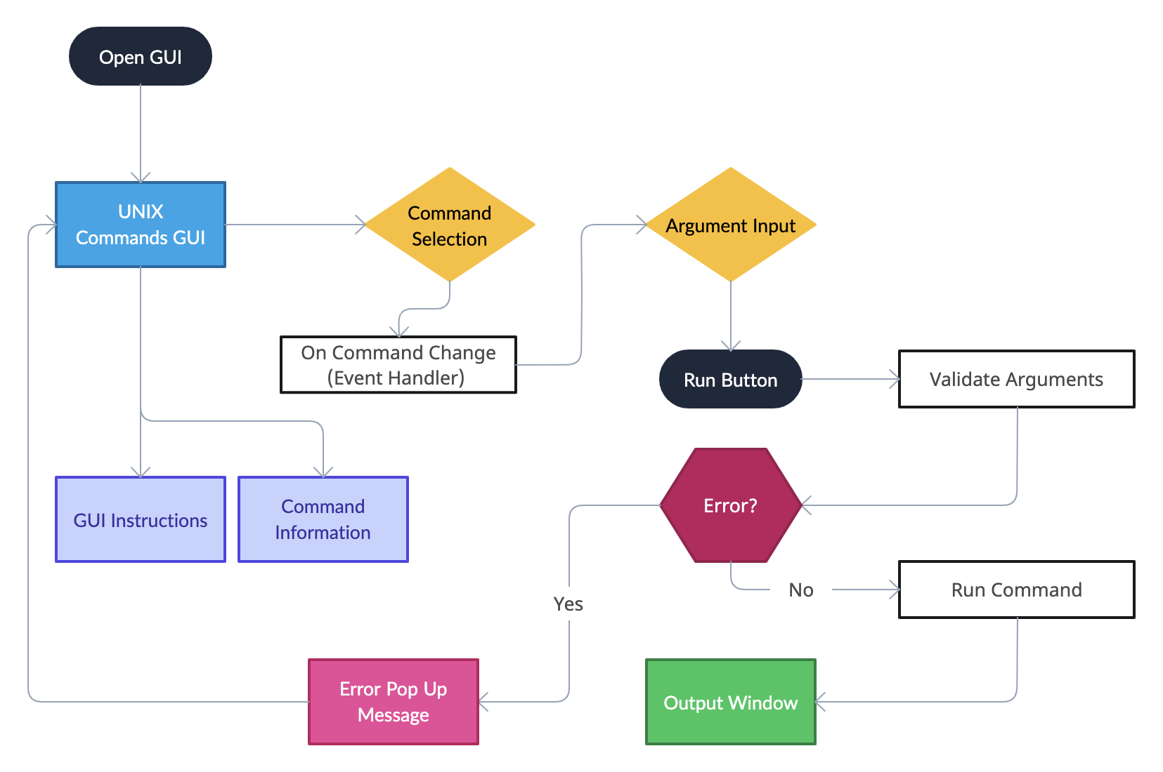
Technical Approach
Architectural Design

Slide 6
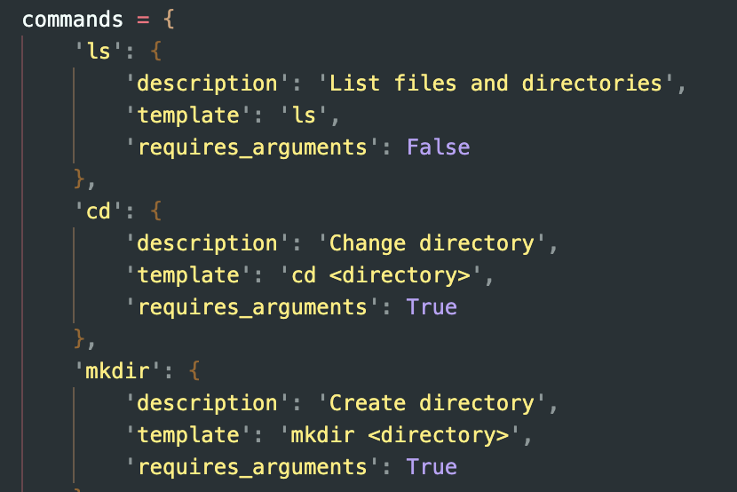
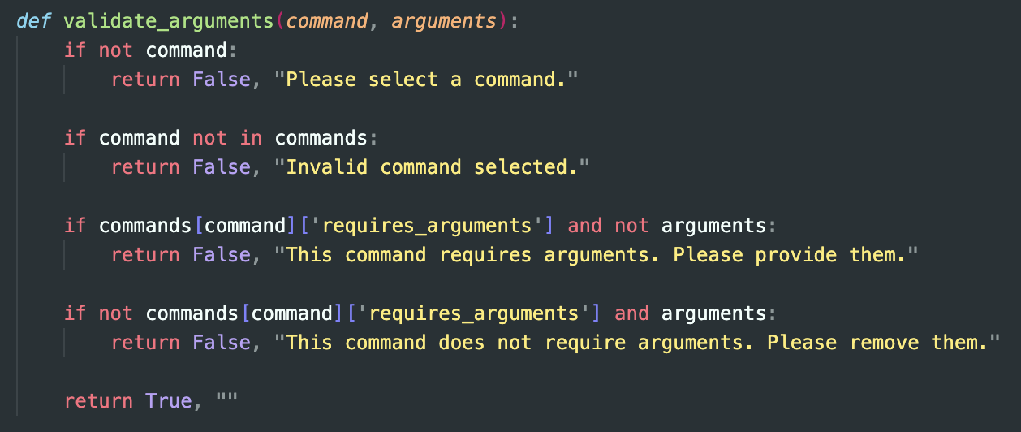
Technical Approach
Code

Slide 7
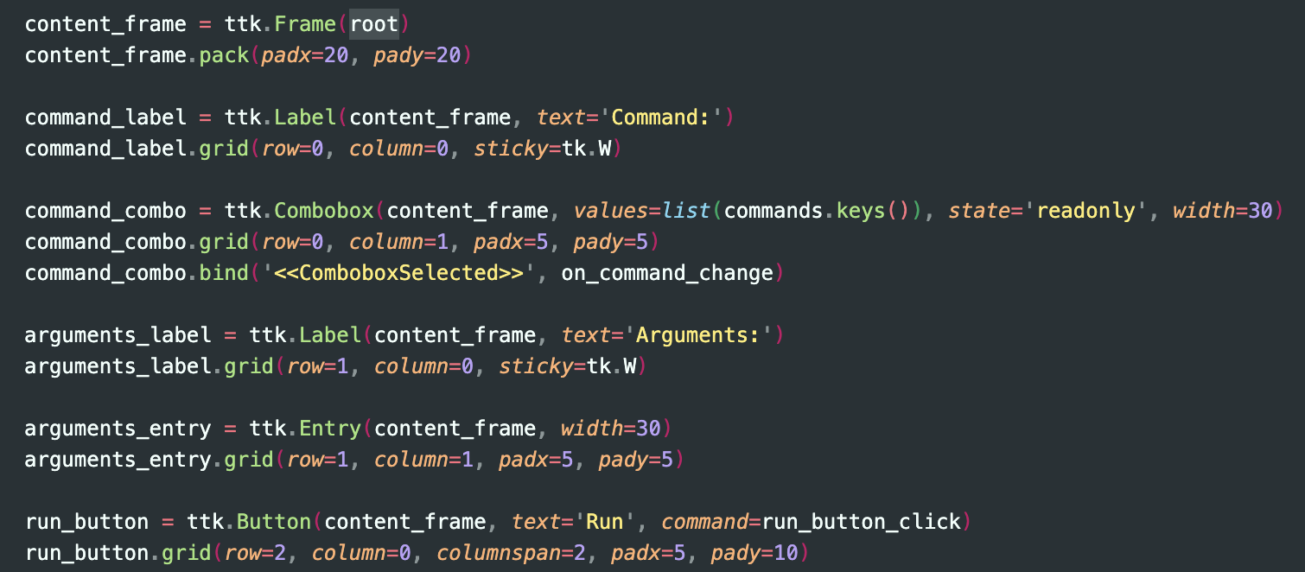
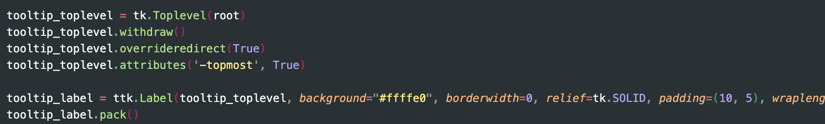
Technical Approach
Code

Slide 8
Technical Approach
Innovative Approach
User-Friendly Experience using a Graphical User Interface (GUI):
The GUI interface makes Unix commands accessible and intuitive for users unfamiliar with the command-line interface.
Menu-Based Command Selection:
Simplifying command execution by allowing users to choose commands from dropdown menus.
Argument Prompting:
Guiding users to input required arguments for each command, reducing errors and improving command context.
Robust Error Handling:
Providing informative and actionable feedback for users when errors occur during command execution.
Security Considerations:
Emphasizing safety by warning users about potentially harmful commands (Ex: 'rm')

Slide 9
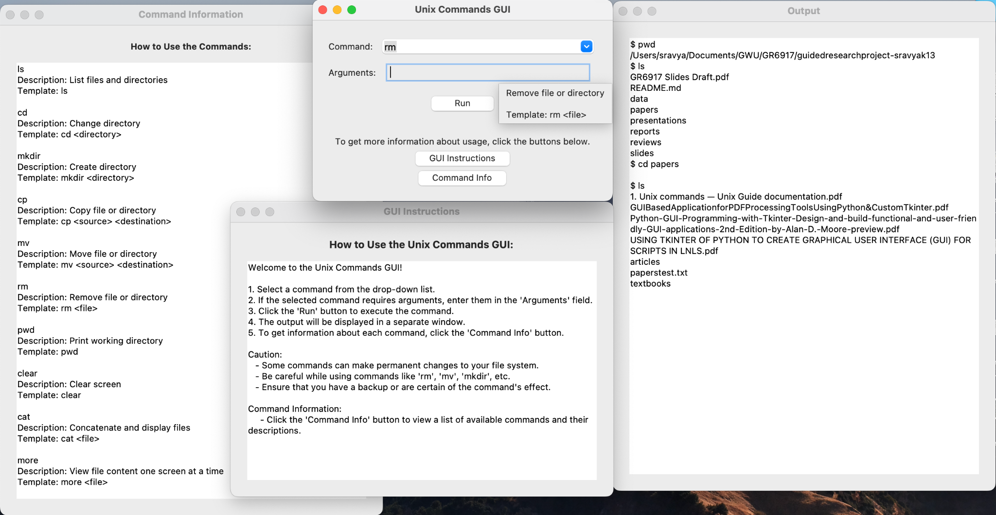
Results
Example

Slide 10
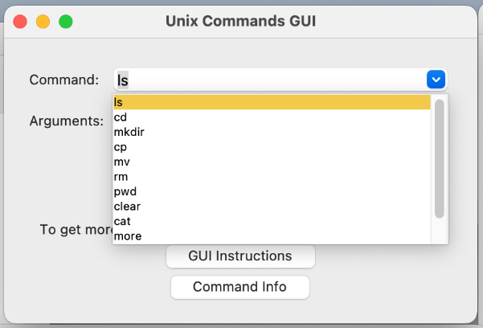
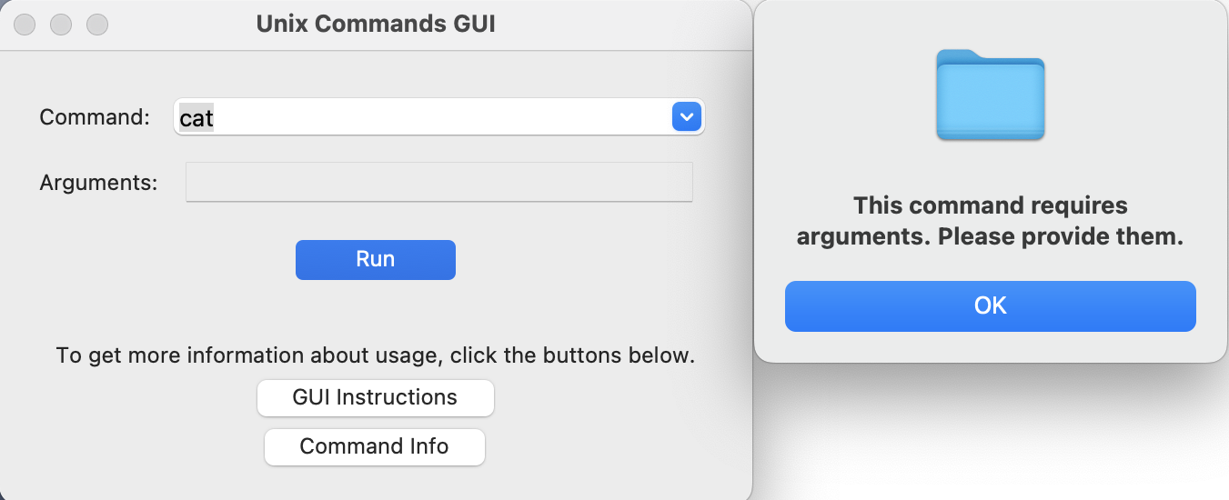
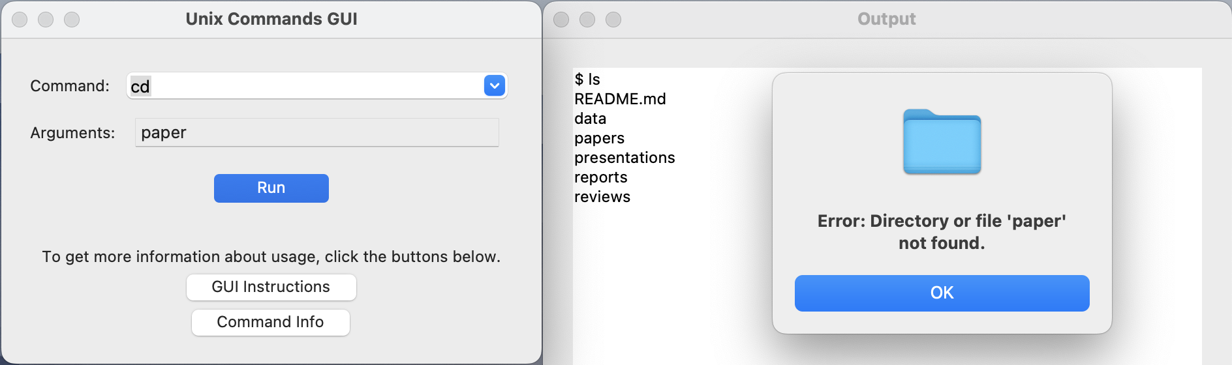
Results
Example

Slide 11
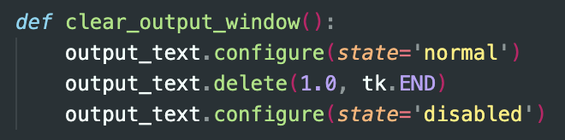
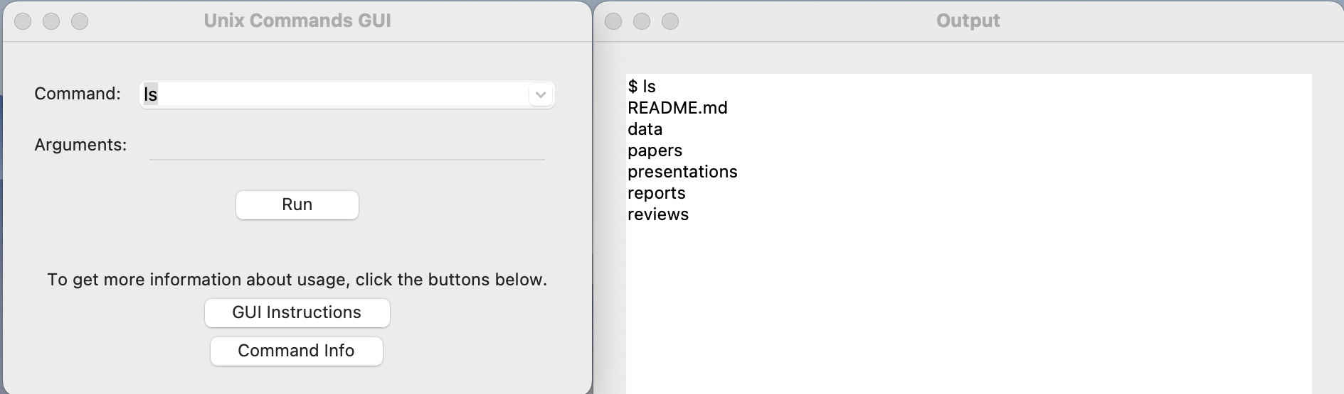
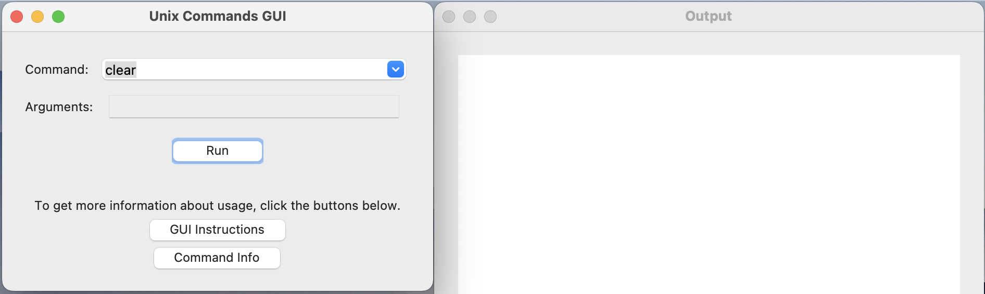
Results
Example

Slide 12
Conclusion
The development of a graphical user interface (GUI) for executing Unix commands on MacOS offers a user-friendly alternative to the traditional command prompt in multiple ways.
Menu-based command selection and argument prompting:
Simplifies the process of running Unix commands, making it accessible to novice users.
Error handling mechanisms and informative feedback:
Enhances the GUI's reliability and helps users understand and rectify potential errors.
Bridges the gap between technical complexity and user accessibility.**
Overall, this project has been successful in its mission to make Unix commands more user-friendly and efficient on MacOS.
There was some difficulty along the way with GUI development and integration with the Terminal, as well as with defining certain aspects of the research.
However, this was addressed by taking more time for research and discussing with the Professors as needed.

Slide 13




Future Work
Interactive Tutorial
Expand Command Support
Tracking Features
Save Output to File
Error Logging and Reporting
Command History
Syntax Highlighting
Make different aspects more easily identifiable
Macro Commands
Ability to bundle several commands together

Slide 14
Questions?
Thank you!

